Slide 1

Module One:
What is Learning?

Slide 2

Dear Teachers and School Facilitators,
Welcome to Module One of the Cognitive Function and Learning Explained Curriculum. This pdf is intended to provide information, activities, and visual aids to support you and your students as they endeavor to understand their minds and how to develop the skills of lifelong learners.
Some activities are derived from Cognitive Behavioral Therapy (CBT) practices but are never intended to be used therapeutically. This curriculum incorporates therapeutic tools but is not a curriculum for therapeutic practice. It is focused on learning, study tools, and self-reflection to help adolescents develop their learning skills.
Thank you for your efforts to connect education to mental health!
Cognitive Function and Learning Explained

Slide 3

Part One
Engagement

Slide 4

Learning is not attained by chance, it must be sought for with ardor and diligence.
Abigail Adams

Slide 5
What is Learning?
“Acquiring knowledge and skills and having them readily available from memory so you can make sense of future problems and opportunities” (Brown et al., p. 2).

Slide 6

The Three-Step Process of Learning
Encoding
Consolidation
Retrieval
The initial learning held in the short-term working memory before being understood and utilized in long-term memory
The reorganizing of memories to give them meaning and connection to past experiences already stored in long-term memory
The ability to pull learned memories and apply them when needed

Slide 7

Evidence-based Approaches to Learning
Spaced Practice
Interleaved Practice
Varied Practice

Slide 8
Spaced
Practice
Spaced practice is shown to improve retention as opposed to back-to-back studying and lessons. Learning new material and practicing to recall the information or skill a day or two later will be more effective in retaining the information than spending consecutive hours trying to memorize it.
Rather than learning four lessons on the same day, spacing the lessons out a week resulted in higher scores on tests.

Slide 9
Interleaved
Practice
Interleaved Practice involves mixing the sequence in which things are learned, rather than mastering a concept before moving on to another one. Math textbooks, for example, are organized by teaching one concept or formula at a time. However, incorporating previously learned material and interleaving practice with the new material will lead to long-term retention.
Interleaved practice feels slower than massed practice. However, “research shows unequivocally that mastery and long-term retention are much better if you interleave practice than if you mass it” (Brown et al., p. 50).

Slide 10
Varied
Practice
Varied practice means including different conditions when practicing knowledge or skills. Solving a problem only one way limits the ability to solve similar problems with other factors.
Varied practice improves your ability to transfer learning from one situation and apply it successfully to another.

Slide 11

Executive Functioning
How we get things done.

Slide 12





Organization
Planning
Working Memory
Metacognition
Task Initiation
Perseverance
Self-Control
Time Management
Attention
Flexibility

Slide 13
Part Two
Learning Strategies

Slide 14

The Argument for
Testing
Periodic quizzing has proven to increase recall of material better than reviewing or rereading.

Slide 15
The Argument for
Testing
“Effortful retrieval makes for stronger learning and retention. We’re easily seduced into believing that learning is better when it’s easier, but the research shows the opposite: When the mind has to work, learning sticks better.”
– Brown et al., p. 43

Slide 16
Desirable Difficulties
Robert and Elizabeth Bjork are psychologists who specialize in how the brain learns. They coined the term desirable difficulties to describe short-term obstacles that make for stronger learning.
Desirable difficulties are the challenges within our capabilities and knowledge that encourage stronger and more durable learning.

Slide 17
Easier isn’t
Better
“Psychologists have uncovered a curious inverse relationship between the ease of retrieval practice and the power of that practice to entrench learning: the easier knowledge or a skill is for you to retrieve, the less your retrieval practice will benefit your retention of it. Conversely, the more effort you have to expend to retrieve knowledge or skill, the more the practice of retrieval will entrench it”
- Brown et al., p. 79

Slide 18
How Effort
Helps
The effort of recall is what reconstructs the brain and incorporates information into long-term memory. Effort strengthens mental connections that allow us to retrieve information faster.

Slide 19
Failure and the Myth of Errorless Learning
“Errorless Learning” was a theory that believed mistakes made by learners were counterproductive and resulted from bad teaching. Information was spoon-fed in small amounts and immediately tested to avoid errors.
This was shown as an ineffective learning strategy as “errors are an integral part” of mastering new material.

Slide 20
3. The hippocampus is primarily involved in:
a) Emotional regulation
b) Motor control
c) Long-term memory formation
d) Vision processing
4. What part of the brain plays a crucial role in language comprehension and processing?
a) Frontal lobe
b) Temporal lobe
c) Parietal lobe
d) Cerebellum
5. The brainstem controls essential functions like breathing, heart rate, and digestion. Which of the following is part of the brainstem?
a) Thalamus
b) Hypothalamus
c) Midbrain
d) Corpus callosum
Brain Anatomy Quiz
1. What part of the brain is responsible for coordinating voluntary movements and balance?
a) Cerebellum
b) Frontal lobe
c) Occipital lobe
d) Brainstem
2. Which area of the brain is associated with processing sensory information such as touch, temperature, and pain?
a) Parietal lobe
b) Temporal lobe
c) Occipital lobe
d) Amygdala

Slide 21
3. The hippocampus is primarily involved in:
a) Emotional regulation
b) Motor control
c) Long-term memory formation
d) Vision processing
4. What part of the brain plays a crucial role in language comprehension and processing?
a) Frontal lobe
b) Temporal lobe
c) Parietal lobe
d) Cerebellum
5. The brainstem controls essential functions like breathing, heart rate, and digestion. Which of the following is part of the brainstem?
a) Thalamus
b) Hypothalamus
c) Midbrain
d) Corpus callosum
Brain Anatomy Quiz
1. What part of the brain is responsible for coordinating voluntary movements and balance?
a) Cerebellum
b) Frontal lobe
c) Occipital lobe
d) Brainstem
2. Which area of the brain is associated with processing sensory information such as touch, temperature, and pain?
a) Parietal lobe
b) Temporal lobe
c) Occipital lobe
d) Amygdala

Slide 22
Part Three
Learning Strategies

Slide 23
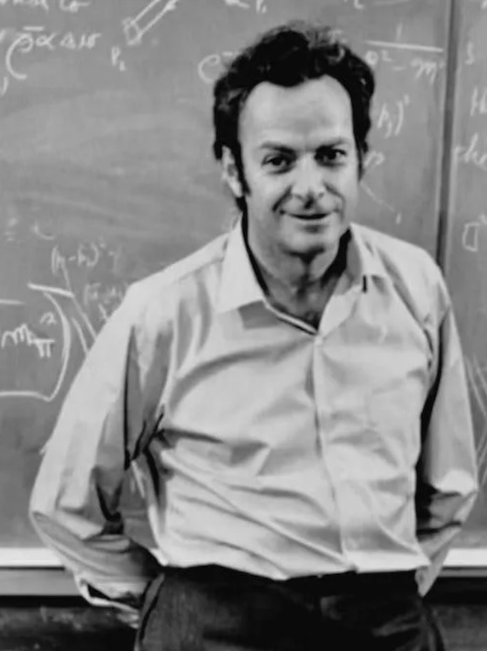
The Feynman Technique
Richard Feynman was a Nobel Prize-winning theoretical physicist who believed teaching served two important purposes: to keep engaged in his field's underlying principles and to contribute to the world.
“I don’t believe I can really do without teaching.”
– Richard P. Feynman

Slide 24




The 4-Step Process
1.
Choose a subject
2.
Explain it as if teaching a child or beginner
3.
Reflect on gaps in your understanding
4.
Simplify and Repeat

Slide 25
The Feynman Technique
Why is it effective?
The Feynman Technique helps us simplify complex or new ideas. Teaching reinforces information while developing communication and critical thinking skills. It helps us recognize gaps and allows us to gain a deeper understanding.

Slide 26




Mnemonic Devices
Memory aids or techniques that help individuals remember information more effectively by associating it with easy-to-recall cues, patterns, or associations.
ABC
Acronyms
Mind Palace
Songs
Poetry &
Rhyme Schemes

Slide 27
Mnemonic Devices
Words formed from the initial letters or parts of a longer phrase or name, where each letter represents one of the words or concepts in the original phrase.
ABC
Acronyms
ROYGBIV

Slide 28
Mnemonic Devices
A memory technique that involves associating information with specific locations or rooms with an imagined building, such as a palace or castle.
Mind Palace

Slide 29
Part Four
A Case Study

Slide 30
Case Study Questions:
What executive function skills is Alex struggling with?
What should Alex focus on to improve their academic performance and overall well-being?
What are some things Alex might do to address their challenges with executive function?
What role does metacognition play in Alex’s ability to recognize and address their executive function deficits?
How can teachers, parents, or peers support Alex in developing their executive function skills and using effective learning strategies?
The Executive Function Challenge
A high school student, Alex, struggles to manage their academic workload and extracurricular activities effectively. They find it challenging to stay organized, prioritize tasks, and meet deadlines, leading to stress and frustration. Their grades are starting to slip, and They’re worried about their academic performance and future prospects.

Slide 31
References and Tools
Books
Brown, P. C., Roediger III, H. L., & McDaniel, M. A. (2014). Make it stick: The science of successful learning. The Belknap Press of Harvard University Press
Sites
https://pcl.sitehost.iu.edu/rgoldsto/courses/dunloskyimprovinglearning.pdf
https://collegeinfogeek.com/learning/
https://learningcenter.unc.edu/tips-and-tools/studying-101-study-smarter-not-harder/
https://www.edutopia.org/article/5-research-backed-studying-techniques
Videos
Executive Function: Your Brain’s Control Center https://youtu.be/sZmElSGKBG8

