Slide 1

Module Two:
Metacognition

Slide 2

Dear Teachers and School Facilitators,
Welcome to Module One of the Cognitive Function and Learning Explained Curriculum. This pdf is intended to provide information, activities, and visual aids to support you and your students as they endeavor to understand their minds and how to develop the skills of lifelong learners.
Some activities are derived from Cognitive Behavioral Therapy (CBT) practices but are never intended to be used therapeutically. This curriculum incorporates therapeutic tools but is not a curriculum for therapeutic practice. It is focused on learning, study tools, and self-reflection to help adolescents develop their learning skills.
Thank you for your efforts to connect education to mental health!
Cognitive Function and Learning Explained

Slide 3

Part One:
Understanding Metacognition

Slide 4
Self-Assessment
I am aware of my strengths and weaknesses as a learner.
  [ ] Rarely or never.
  [ ] Sometimes.
  [ ] Often or always.
I use strategies like self-questioning and self-monitoring to check my understanding.
  [ ] Rarely or never.
  [ ] Sometimes.
  [ ] Often or always.
I reflect on my learning experiences and identify what worked well and what could be improved.
  [ ] Rarely or never.
  [ ] Sometimes.
  [ ] Often or always.
When I encounter a challenging task, I:
  [ ] Dive right into the task without planning or thinking about my approach.
  [ ] Pause to think about the best strategies or methods to use.
  [ ] Reflect on my past experiences and consider how they can help me approach the task.
I set specific goals for my learning and monitor my progress regularly.
  [ ] Rarely or never.
  [ ] Sometimes.
  [ ] Often or always.

Slide 5
I use metacognitive strategies like summarizing, predicting, and organizing information to enhance my understanding.
  [ ] Rarely or never.
  [ ] Sometimes.
  [ ] Often or always.
I can explain my thinking processes and the reasoning behind my learning strategies.
  [ ] Rarely or never.
  [ ] Sometimes.
  [ ] Often or always.
I actively seek feedback from teachers, peers, or mentors to improve my learning strategies.
  [ ] Rarely or never.
  [ ] Sometimes.
  [ ] Often or always.
Self-Assessment
I can identify when I am struggling with a concept or task and seek help or additional resources.
  [ ] Rarely or never.
  [ ] Sometimes.
  [ ] Often or always.
I am able to adapt my learning strategies based on the task and my goals.
  [ ] Rarely or never.
  [ ] Sometimes.
  [ ] Often or always.

Slide 6

What is Metacognition?
Knowing about and controlling your own thinking to learn better.

Slide 7
Why does it matter?
Metacognition matters for learning because it helps you understand how you learn best and lets you adjust your strategies to improve your learning outcomes.

Slide 8

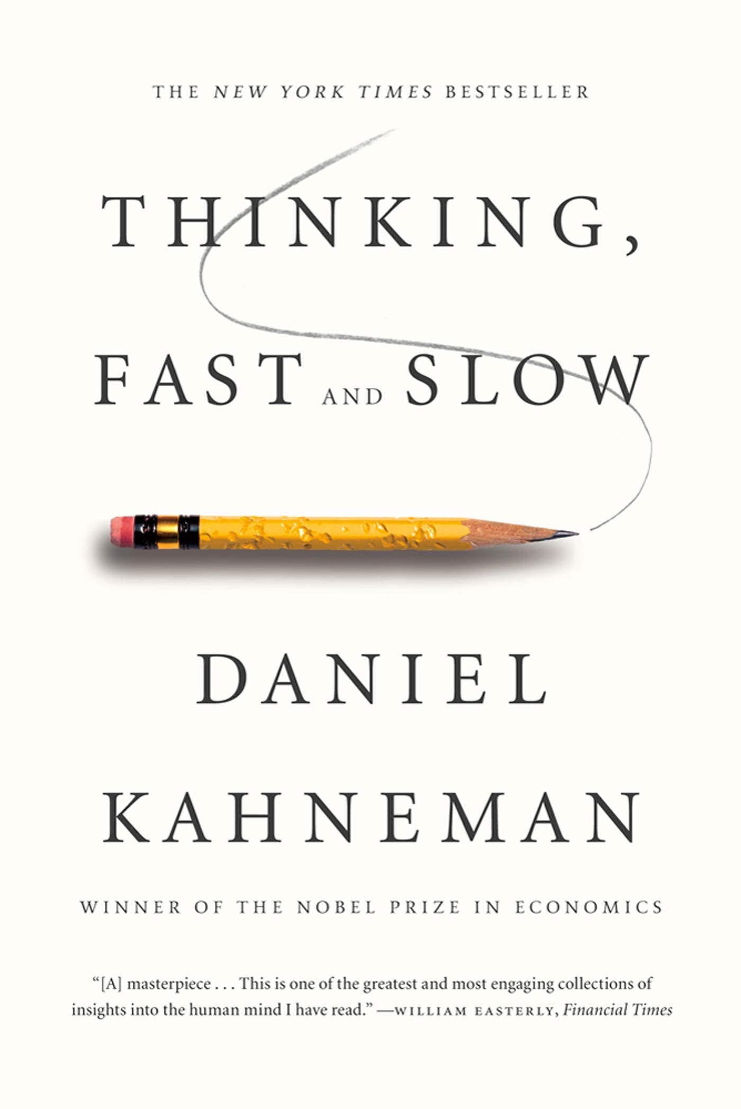
Two Systems of Knowing
Kahneman’s book, Thinking, Fast and Slow, explains thought processes. The book simplifies the thinking mind into two “systems,” System 1 and System 2.
System 1 refers to the part of the brain that executes immediate or reactionary thinking. This is the thinking that creates biases and misinformation
System 2 is the slower process of thought typically used when learning a new skill or deeper thinking/analysis.

Slide 9
Why does it matter?
If we understand that our first response to an event or new information is reactive, we can recognize that our first response may not be the truth but simply a first impression.
If we take the time to process and consider new information, we may choose a better, more informed response.

Slide 10
False Perceptions
Illusions
of
Knowing
Cognitive Biases
Distortions of Memory

Slide 11
False Perceptions
A mistaken or inaccurate interpretation of sensory information or experiences can lead to a perception that does not align with reality. This can include misinterpreting visual, auditory, or other sensory cues, as well as misjudging the meaning or significance of events or situations.

Slide 12
Cognitive Bias
A deviation from rationality in judgment or decision-making. It is often influenced by subjective factors such as personal beliefs, experiences, or emotions. These biases can lead people to make illogical or ill-informed decisions.

Slide 13
Distortions of Memory
Memory inaccuracies or alterations that occur when recalling past events or experiences. These distortions can result from various factors, such as the passage of time, personal biases, emotions, or suggestions from others.

Slide 14
Illusions
of
Knowing
Brown et al. provided a handful of examples of illusions, biases, and memory distortions we can experience

Slide 15








Flaws in the System
False Narratives
Imagination Inflation
Suggestion
Interference
False Consensus Effect
Curse of Knowledge
Hindsight Bias
Fluency Illusions

Slide 16
False Narratives
The hunger for narrative can lead to us creating stories that distort memories and create the framework for future experiences with inaccurate information.
Maria, a high school student, has always been diligent about her studies. However, she didn’t do well on an Algebra test and is beginning to doubt her abilities. She gets higher scores in English and History and determines she’s “not a math person.” This false narrative leads her to question her abilities and overlook her past success and potential for improvement.

Slide 17
Imagination Inflation
The phenomenon in which a person creates a false memory when asked to imagine an event vividly. Memory is unable to be separated from imagination.
Jay and Blake disagree about who the last person to use a lost Nintendo Switch controller was. Jay swears that he remembers handing the controller to Blake, but Blake asserts Jay never gave him the controller. Jay even goes as far as describing what they were wearing and the time of day he gave Blake the controller. The next day, Jay finds the controller in the hoodie pocket he was wearing the day before.

Slide 18
Suggestion
The word choice in a question can influence the answer given.
This is known as “leading the witness” in the legal system and applies to memories.
Sam, Ali, and Yuna are planning a trip. Sam insists on going to a museum that Ali and Yuna aren’t very interested in. When Sam leaves the room, Ali turns to Yuna and asks, “Don’t you think they’re being selfish? Neither of us wants to go.” It’s true that Yuna isn’t as interested in the museum, but she also knows that Sam might not get the chance to go any other time. However, Yuna feels pressured to agree since it’s true that she doesn’t want to go, which means Sam is being selfish.

Slide 19
Interference
Other events can distort memories, leading to false or inaccurate recall.
During Spanish, Sammi learns several new vocabulary words. Later that day, they attend a French class where they learn similar-sounding words in French. When trying to recall the Spanish words the next day, Sammi struggles because the French words learned afterward interfere with their ability to remember the Spanish vocabulary accurately.

Slide 20
Curse of Knowledge
The tendency to underestimate how long it takes for someone to learn something that the teacher has mastered.
Anna is tutoring her little sister in math. Anna is a high school student in AP Precalculus while her sister is beginning to learn multiplication. Her sister is struggling to understand multiplying by two. Anna feels frustrated that her sister isn’t getting something that is so obvious and simple, forgetting what it was like to learn multiplication for the first time.

Slide 21
Hindsight Bias
A person who thinks they knew something all along but could not have predicted the event before it occurred.
Kenji loves to read mystery novels. In the last chapter of his current read, when the culprit is revealed, he exclaims, “I knew it; she did it!” In truth, the culprit was one of the suspects on his list, but he wasn’t entirely sure. It’s only in hindsight that the culprit's identity is obvious.

Slide 22
Fluency Illusions
Mistaking understanding for mastery. Someone may explain something simply, but we do not fully understand the concepts ourselves.
In Biology class, Imani’s teacher always gives the lesson slides as handouts to the class. Imani decides she doesn’t need to take notes or read the textbook because the slide images look easy to remember. When taking the test, she recognizes the information from the slides but can’t explain the roles of parts of the cell in her own words.

Slide 23
False Consensus Effect
The assumption that others share our beliefs and understanding of the world.
Angela makes plans to meet with Marisol for coffee. Angela arrives at the coffee shop ten minutes early. Ten minutes after the agreed meeting time, Marisol arrives. Angela is upset, thinking that Marisol is rude for not prioritizing being on time. When Marisol’s family usually has social gatherings, they consider the proposed time as a timeframe rather than a specific time. This leads to conflict between Angela and Marisol.

Slide 24
Part Two:
Metacognitive Strategies

Slide 25






DEVELOPING METACOGNITIVE SKILLS
Know What You Don’t Know
Prepare and Plan
Set Goals
Ask Questions
Seek Out Feedback

Slide 26
Know What You Don’t Know
River likes to use pretests and post-tests for each unit in their textbook to test their understanding of the material. Rather than feeling frustrated when they get something wrong, they use the information as a guide for what they need to focus on.

Slide 27
Prepare and Plan
Tori uses a planner to keep track of tasks and due dates. She uses her calendar app for time blocking. She knows that plans may change or things may come up, so she gives buffers of time in her day and keeps a flexible schedule to help prioritize important assignments or events while being able to adjust to the unexpected.

Slide 28
Set Goals
Carlos likes to start his day by choosing his top three priorities based on long-term goals. One of his long-term goals is to go to college. He knows he needs to take the SAT or ACT for college applications. Today, he set a goal to meet with a friend at the library to go over SAT prep questions in math for 30 minutes. Breaking his long-term goal into smaller, measurable goals helps keep him focused and on task.

Slide 29
Ask Questions
In English, Mara is listening to the teacher go over the study guide for the next test. She notices that no one else in the class says anything when the teacher asks if there are any questions. Mara hesitates but decides to ask about a poem she doesn’t understand. She hears several of her classmates sigh in relief. “Yeah, I don’t get that part,” another classmate agrees. Mara’s teacher explains the poem and literary techniques, and Mara feels relieved that she asked for help.

Slide 30
Seek Out Feedback
Lee has a presentation due at the end of the week. He’s feeling nervous, so he decides to practice in front of different people, including family members and friends. A friend mentions that Lee is speaking a little too fast and mumbling during some parts of the presentation. Lee knows that his friend cares about him and wants him to do well, so he embraces the feedback along with the other feedback he was given. He gets a grade he is happy with on the presentation.

Slide 31
Part Three:
Applying Metacognition

Slide 32

A Metacognitive Master
Emma is a high school student known for her excellent academic performance and effective learning strategies. She demonstrates strong metacognitive skills that contribute to her success in various subjects.

Slide 33
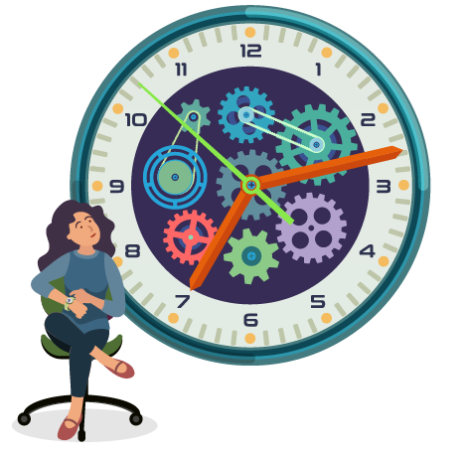
Time Management
Emma is aware of her schedule and priorities. She uses a planner to organize her tasks, sets realistic goals for each study session, and allocates time for studying, homework, extracurricular activities, and relaxation. She regularly reviews her schedule and adjusts it as needed to ensure she stays on track with her academic goals.

Slide 34

Study Strategies
Emma employs a variety of effective study strategies based on the type of material and her learning preferences. For example, she uses active learning techniques such as summarizing, questioning, and self-testing to deepen her understanding of complex concepts. She also practices distributed practice by spacing out her study sessions over time to enhance retention and long-term learning.

Slide 35

Self-Reflection
Emma regularly reflects on her learning progress and strategies. After completing an assignment or exam, she evaluates her performance, identifies areas of strength and areas for improvement, and adjusts her study methods accordingly. She seeks feedback from teachers and peers to gain different perspectives and insights into her learning process.

Slide 36

Metacognitive Monitoring
Emma monitors her cognitive processes while studying and completing tasks. She pays attention to her comprehension, attention, and level of engagement, making adjustments if she notices any difficulties or distractions. For example, if she finds herself getting distracted while studying, she takes a short break, practices mindfulness techniques, or changes her study environment to improve focus.

Slide 37
Goal Setting
Emma sets specific, measurable, achievable, relevant, and time-bound (SMART) goals for her academic performance. She breaks down larger goals into smaller tasks and milestones, tracks her progress regularly, and celebrates her achievements along the way. This goal-oriented approach motivates her to stay focused and disciplined in pursuing her academic aspirations.

Slide 38
Give Yourself Grace
Emma understands that there will be times when these strong academic habits might get interrupted or things may disrupt her routine. She does her best not to get discouraged. She reminds herself that perfection is not realistic, breaks are healthy, and habits can always be started again.

Slide 39

Advice from Your Wisest Self
Imagine you have lived a long, full life. You’ve been given the chance to travel back in time to give guidance to your present self. Answer the following questions from the perspective of your future, wiser self.

Slide 40
Advice from Your Wisest Self
Looking back, what accomplishments, experiences, or realizations mattered most?
What do you hope you will be remembered for?
What advice do you want to give your present self?
Based on this advice, what goals or values are most important?
What current steps can you take toward these goals or values?

Slide 41
Part Four:
Metacognition and Self-regulated Learning

Slide 42

Self-Regulated Learning
The process through which individuals actively take control of their learning by setting goals, monitoring their progress, employing strategies to enhance learning, and adjusting their approach based on feedback and reflection.

Slide 43
Why Does it Matter?
Self-regulated learning means taking control of your own learning journey. It’s about setting goals, using strategies that work for you, and checking your progress along the way. When you’re a self-regulated learner, you become more efficient, adaptable, and motivated to succeed.

Slide 44
Challenge 1: Time Management
Marco realizes that he has limited time to review all the material for her exams. He has multiple subjects to study for and feels overwhelmed by the amount of content he needs to cover.
Challenge 2: Study Strategies
Marco has been using the same study strategies for years, such as reading and highlighting notes, but he's not sure if these strategies are effective for long-term retention and understanding of the material.
Challenge 3: Test Anxiety
Marco experiences test anxiety, especially during high-stakes exams. He often struggles to focus and recall information under pressure, leading to lower-than-expected grades despite knowing the material.
The Exam Preparation Dilemma
A Metacognitive Case Study
Marco is a high school student preparing for his final exams. He has always been a diligent student and usually does well in his classes. However, as the exams approach, Marco faces a dilemma that requires metacognitive skills.

Slide 45
Challenge 1: Time Management
Marco realizes that he has limited time to review all the material for her exams. He has multiple subjects to study for and feels overwhelmed by the amount of content he needs to cover.
Challenge 2: Study Strategies
Marco has been using the same study strategies for years, such as reading and highlighting notes, but he's not sure if these strategies are effective for long-term retention and understanding of the material.
Challenge 3: Test Anxiety
Marco experiences test anxiety, especially during high-stakes exams. He often struggles to focus and recall information under pressure, leading to lower-than-expected grades despite knowing the material.
The Exam Preparation Dilemma
A Metacognitive Case Study
Marco is a high school student preparing for his final exams. He has always been a diligent student and usually does well in his classes. However, as the exams approach, Marco faces a dilemma that requires metacognitive skills.

Slide 46
Case Study Questions
What are the specific challenges Marco is facing in preparing for his final exams?
How can metacognitive skills help Marco improve his time management and study strategies?
What metacognitive strategies can Marco use to reduce test anxiety and improve his performance during exams?
How can Marco monitor his progress and evaluate the effectiveness of his study strategies using metacognition?
If you were Marco's academic advisor, what advice would you give him to enhance his metacognitive skills and succeed in his exams?
Challenge 1: Time Management
Marco realizes that he has limited time to review all the material for her exams. He has multiple subjects to study for and feels overwhelmed by the amount of content he needs to cover.
Challenge 2: Study Strategies
Marco has been using the same study strategies for years, such as reading and highlighting notes, but he's not sure if these strategies are effective for long-term retention and understanding of the material.
Challenge 3: Test Anxiety
Marco experiences test anxiety, especially during high-stakes exams. He often struggles to focus and recall information under pressure, leading to lower-than-expected grades despite knowing the material.

Slide 47

How has setting specific learning goals helped you stay focused and motivated in the past?
Have you used self-monitoring strategies to track your progress on a project or assignment? What did you learn about your study habits and areas for improvement?
Think about a challenging task you encountered recently. How could employing strategies, such as self-reflection or organization, have helped you overcome the obstacles and achieve your goals?
Self-Reflection

Slide 48
Part Five:
Metacognition and Academic Success

Slide 49
DISCUSSION
Study Habits
What does metacognition mean to you, and how do you currently use metacognitive strategies in your study routine?
How can metacognitive strategies such as planning, monitoring, and evaluating be integrated into daily study habits to improve learning outcomes?
Share an example of a time when using metacognitive strategies helped you understand and remember challenging material more effectively.

Slide 50
DISCUSSION
Test Preparation
How do you typically prepare for tests, exams, or assessments? Do you think integrating metacognitive strategies can enhance your test preparation process?
Discuss specific metacognitive strategies that can be applied during test preparation, such as self-testing, elaborative interrogation, and mnemonic devices.
Share your thoughts on how metacognitive strategies can help manage test anxiety and improve performance during exams.

Slide 51
DISCUSSION
Problem-Solving Approaches
When faced with a difficult problem or task, what strategies do you currently use to approach the situation? How might metacognitive strategies enhance your problem-solving abilities?
Consider metacognitive strategies such as breaking down problems, monitoring progress, seeking feedback, and self-reflection. How can these strategies be integrated into your problem-solving approach?

Slide 52
References and Tools
Books
Brown, P. C., Roediger III, H. L., & McDaniel, M. A. (2014). Make it stick: The science of successful learning. The Belknap Press of Harvard University Press
Kahneman, D. (2011). Thinking, fast and slow. Farrar, Straus and Giroux.
Newport, C. (2006). How to be a straight-A student: The unconventional strategies real college students use to score high while studying less. Three Rivers Press.
Sites
https://www.therapistaid.com/therapy-worksheet/your-wisest-self
Videos
Metacognition: The Skill That Promotes Advanced Learning. https://www.youtube.com/watch?v=elZFL4FLVLE
Cognitive Bias | Ethics Defined. https://www.youtube.com/watch?v=TlOUnOWfw3M
Survivorship Bias. https://youtu.be/P9WFpVsRtQg?si=MTSzMsFsRy3jmJyp

