Slide 1

Module One:
What is Learning?

Slide 2

Dear Teachers and School Facilitators,
Welcome to Module One of the Cognitive Function and Learning Explained Curriculum. This pdf is intended to provide information, activities, and visual aids to support you and your students as they endeavor to understand their minds and how to develop the skills of lifelong learners.
Some activities are derived from Cognitive Behavioral Therapy (CBT) practices but are never intended to be used therapeutically. This curriculum incorporates therapeutic tools but is not a curriculum for therapeutic practice. It is focused on learning, study tools, and self-reflection to help adolescents develop their learning skills.
Thank you for your efforts to connect education to mental health!
Cognitive Function and Learning Explained

Slide 3

Part One
Engagement

Slide 4

Learning is not attained by chance, it must be sought for with ardor and diligence.
Abigail Adams

Slide 5
What is Learning?
“Acquiring knowledge and skills and having them readily available from memory so you can make sense of future problems and opportunities” (Brown et al., p. 2).

Slide 6

The Three-Step Process of Learning
Encoding
Consolidation
Retrieval
The initial learning held in the short-term working memory before being understood and utilized in long-term memory
The reorganizing of memories to give them meaning and connection to past experiences already stored in long-term memory
Also known as recall. The ability to pull learned memories and apply them when needed.

Slide 7

Evidence-based Approaches to Learning
Spaced Practice
Interleaved Practice
Varied Practice

Slide 8
Spaced
Practice
Spaced practice is a learning method where study sessions are spread out over time to improve retention and understanding of the material. Spaced practice is shown to improve retention as opposed to back-to-back studying and lessons.
Learning new material and practicing to recall the information or skill a day or two later will be more effective than spending consecutive hours trying to memorize it.

Slide 9
Spaced
Practice
While studying Spanish, Naomi studies vocabulary words for 15 minutes every day, rather than trying to learn all the words in one long study session the night before the test. This is spaced practice.

Slide 10
Interleaved
Practice
Interleaved Practice involves mixing the sequence in which things are learned, rather than mastering a concept before moving on to another one.
Interleaved practice feels slower than massed practice. However, “research shows unequivocally that mastery and long-term retention are much better if you interleave practice than if you mass it” (Brown et al., p. 50).

Slide 11
Interleaved
Practice
Jacob is studying math. He spends 20 minutes solving algebra problems, then switches to geometry problems for 20 minutes, and finally works on some calculus problems for 20 minutes. Mixing different problems in a single study session helps him identify the correct formula or concept to apply for each math subject.

Slide 12
Varied
Practice
Varied practice means including different conditions when practicing knowledge or skills. Solving a problem only one way limits the ability to solve similar problems with other factors.
Varied practice improves your ability to transfer learning from one situation and apply it successfully to another.

Slide 13
Varied
Practice
In English class, Erik works on his writing skills by drafting essays, writing short stories, composing poems, and creating research reports. By engaging in different types of writing assignments, he develops a more versatile writing ability and better adapts to various writing tasks and styles.

Slide 14

Executive Functioning
How we get things done.

Slide 15

Executive Functioning
Executive functioning refers to a set of mental skills that help people plan, focus, remember things, and manage tasks. These skills include problem-solving, staying flexible, and controlling impulses.

Slide 16





Organization
Planning
Working Memory
Metacognition
Task Initiation
Perseverance
Self-Control
Time Management
Attention
Flexibility

Slide 17

Reflection
How does understanding the three-step process of learning help us when studying or learning something new?
How can you use spaced practice in your study routine?
How can you use interleaved practice in your study routine?
How can you use varied practice in your study routine?
How do you think executive functioning skills can help you in everyday life?

Slide 18
Part Two
Learning Strategies

Slide 19

The Argument for
Testing
Periodic quizzing has proven to increase recall of material better than reviewing or rereading.

Slide 20
The Argument for
Testing
“Effortful retrieval makes for stronger learning and retention. We’re easily seduced into believing that learning is better when it’s easier, but the research shows the opposite: When the mind has to work, learning sticks better.”
– Brown et al., p. 43

Slide 21
Desirable Difficulties
Robert and Elizabeth Bjork are cognitive psychologists who specialize in how the brain learns. They coined the term desirable difficulties to describe short-term obstacles that make for stronger learning.
Desirable difficulties are the challenges within our capabilities and knowledge that encourage stronger and more durable learning.

Slide 22
Easier isn’t
Better
“Psychologists have uncovered a curious inverse relationship between the ease of retrieval practice and the power of that practice to entrench learning: the easier knowledge or a skill is for you to retrieve, the less your retrieval practice will benefit your retention of it. Conversely, the more effort you have to expend to retrieve knowledge or skill, the more the practice of retrieval will entrench it”
- Brown et al., p. 79

Slide 23
How Effort
Helps
The effort of recall is what reconstructs the brain and incorporates information into long-term memory. Effort strengthens mental connections that allow us to retrieve information faster.

Slide 24
Failure and the Myth of Errorless Learning
“Errorless Learning” was a theory that believed mistakes made by learners were counterproductive and resulted from bad teaching. Information was spoon-fed in small amounts and immediately tested to avoid errors.
This was shown as an ineffective learning strategy as “errors are an integral part” of mastering new material.

Slide 25
3. The hippocampus is primarily involved in:
a) Emotional regulation
b) Motor control
c) Long-term memory formation
d) Vision processing
4. What part of the brain plays a crucial role in language comprehension and processing?
a) Frontal lobe
b) Temporal lobe
c) Parietal lobe
d) Cerebellum
5. The brainstem controls essential functions like breathing, heart rate, and digestion. Which of the following is part of the brainstem?
a) Thalamus
b) Hypothalamus
c) Midbrain
d) Corpus callosum
Brain Anatomy Quiz
1. What part of the brain is responsible for coordinating voluntary movements and balance?
a) Cerebellum
b) Frontal lobe
c) Occipital lobe
d) Brainstem
2. Which area of the brain is associated with processing sensory information such as touch, temperature, and pain?
a) Parietal lobe
b) Temporal lobe
c) Occipital lobe
d) Amygdala

Slide 26
3. The hippocampus is primarily involved in:
a) Emotional regulation
b) Motor control
c) Long-term memory formation
d) Vision processing
4. What part of the brain plays a crucial role in language comprehension and processing?
a) Frontal lobe
b) Temporal lobe
c) Parietal lobe
d) Cerebellum
5. The brainstem controls essential functions like breathing, heart rate, and digestion. Which of the following is part of the brainstem?
a) Thalamus
b) Hypothalamus
c) Midbrain
d) Corpus callosum
Brain Anatomy Quiz
1. What part of the brain is responsible for coordinating voluntary movements and balance?
a) Cerebellum
b) Frontal lobe
c) Occipital lobe
d) Brainstem
2. Which area of the brain is associated with processing sensory information such as touch, temperature, and pain?
a) Parietal lobe
b) Temporal lobe
c) Occipital lobe
d) Amygdala

Slide 27
Reflection
Have you ever felt frustrated when something was difficult to understand?
How did you respond?
How can we use the understanding that desirable difficulties increase learning and errorless learning decreases it?
What are some ways to use the testing effect in a study routine?

Slide 28
Part Three
Learning Strategies

Slide 29
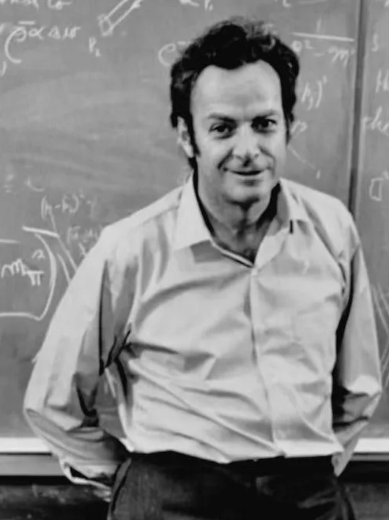
The Feynman Technique
Richard Feynman was a Nobel Prize-winning theoretical physicist who believed teaching served two important purposes: to keep engaged in his field's underlying principles and to contribute to the world.
“I don’t believe I can really do without teaching.”
– Richard P. Feynman

Slide 30




The 4-Step Process
1.
Choose a subject
2.
Explain it as if teaching a child or beginner
3.
Reflect on gaps in your understanding
4.
Simplify and Repeat

Slide 31
The Feynman Technique
Why is it effective?
The Feynman Technique helps us simplify complex or new ideas. Teaching reinforces information while developing communication and critical thinking skills. It helps us recognize gaps and allows us to gain a deeper understanding.

Slide 32




Mnemonic Devices
Memory aids or techniques that help individuals remember information more effectively by associating it with easy-to-recall cues, patterns, or associations.
ABC
Acronyms
Mind Palace
Songs
Poetry &
Rhyme Schemes

Slide 33
Mnemonic Devices
Words formed from the initial letters or parts of a longer phrase or name, where each letter represents one of the words or concepts in the original phrase.
ABC
Acronyms
ROYGBIV

Slide 34
Mnemonic Devices
A memory technique that involves associating information with specific locations or rooms with an imagined building, such as a palace or castle.
Mind Palace

Slide 35
Part Four
A Case Study

Slide 36
Case Study Questions:
What executive function skills is Alex struggling with?
What should Alex focus on to improve their academic performance and overall well-being?
What are some things Alex might do to address their challenges with executive function?
What role does metacognition (self-reflection) play in Alex’s ability to recognize and address their executive function deficits?
How can teachers, parents, or friends support Alex in developing their executive function skills and using effective learning strategies?
The Executive Function Challenge
A high school student, Alex, struggles to manage their academic workload and extracurricular activities effectively. They find it challenging to stay organized, prioritize tasks, and meet deadlines, leading to stress and frustration. Their grades are starting to slip, and they’re worried about their academic performance and future opportunities.

Slide 37
Part Five
Review

Slide 38
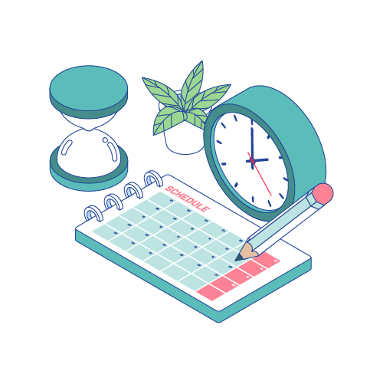
Review
Can you explain what executive functioning is?
What kinds of things are considered executive functioning?
Do you think it’s helpful to have strong executive function skills? Why or why not?
Do you think it’s necessary to know how the brain learns? Why or why not?
Are there any areas of executive functioning that you’d like to work on?

Slide 39
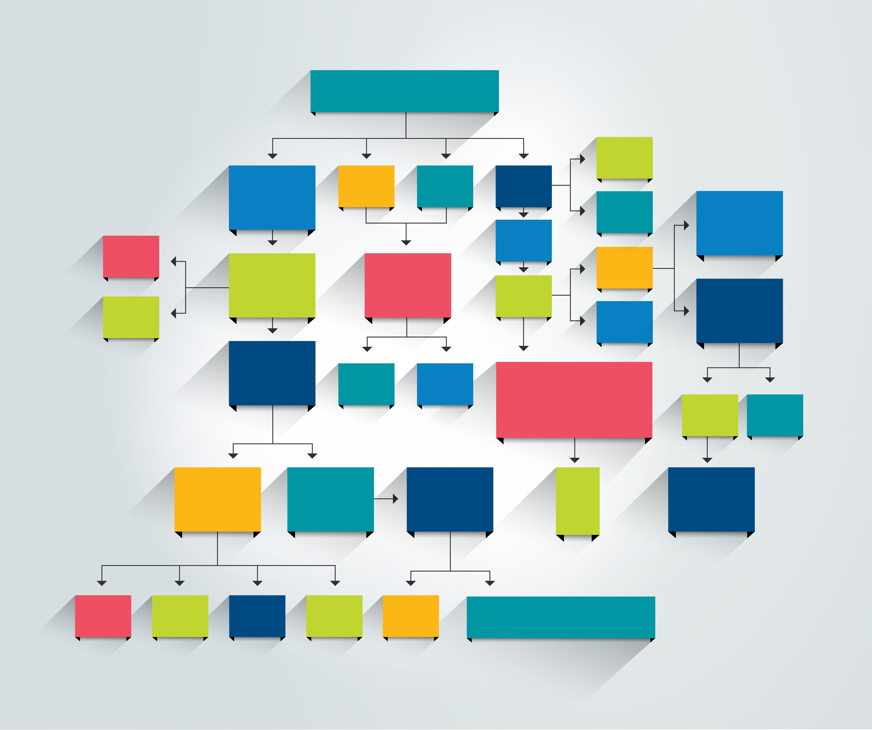
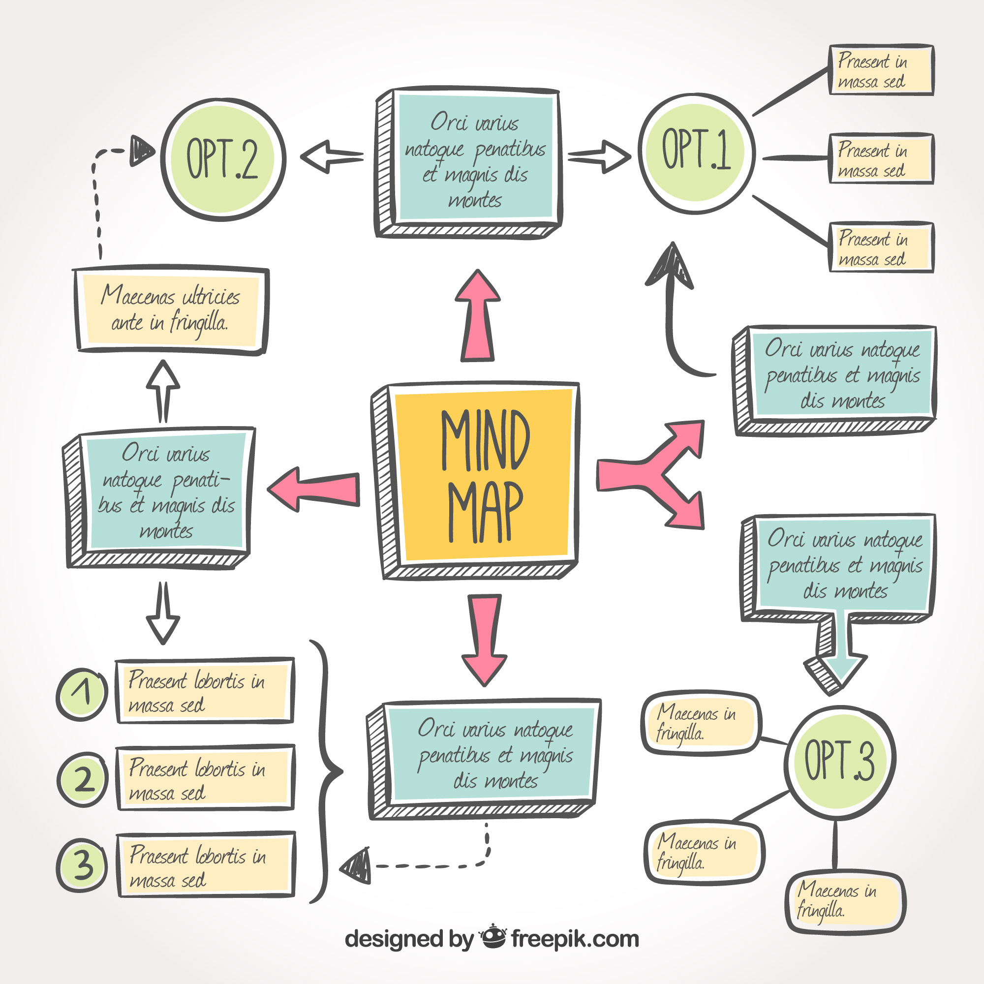
Creating a Concept Map

Slide 40
Creating a Concept Map
Choose a Topic: Start with the main idea or topic you want to explore
Write the Main Idea: Write the main idea in a large circle or box at the center of your paper/digital canvas
Identify Key Concepts: Think of related ideas or key concepts that connect to the main idea
Draw Connections: Draw lines to connect the key concepts to the main idea. Add labels to the lines to show how they are related.
Add Details: For each key concept. Think of supporting details or sub-concepts. Write these near each key concept and connect them with lines.

Slide 41
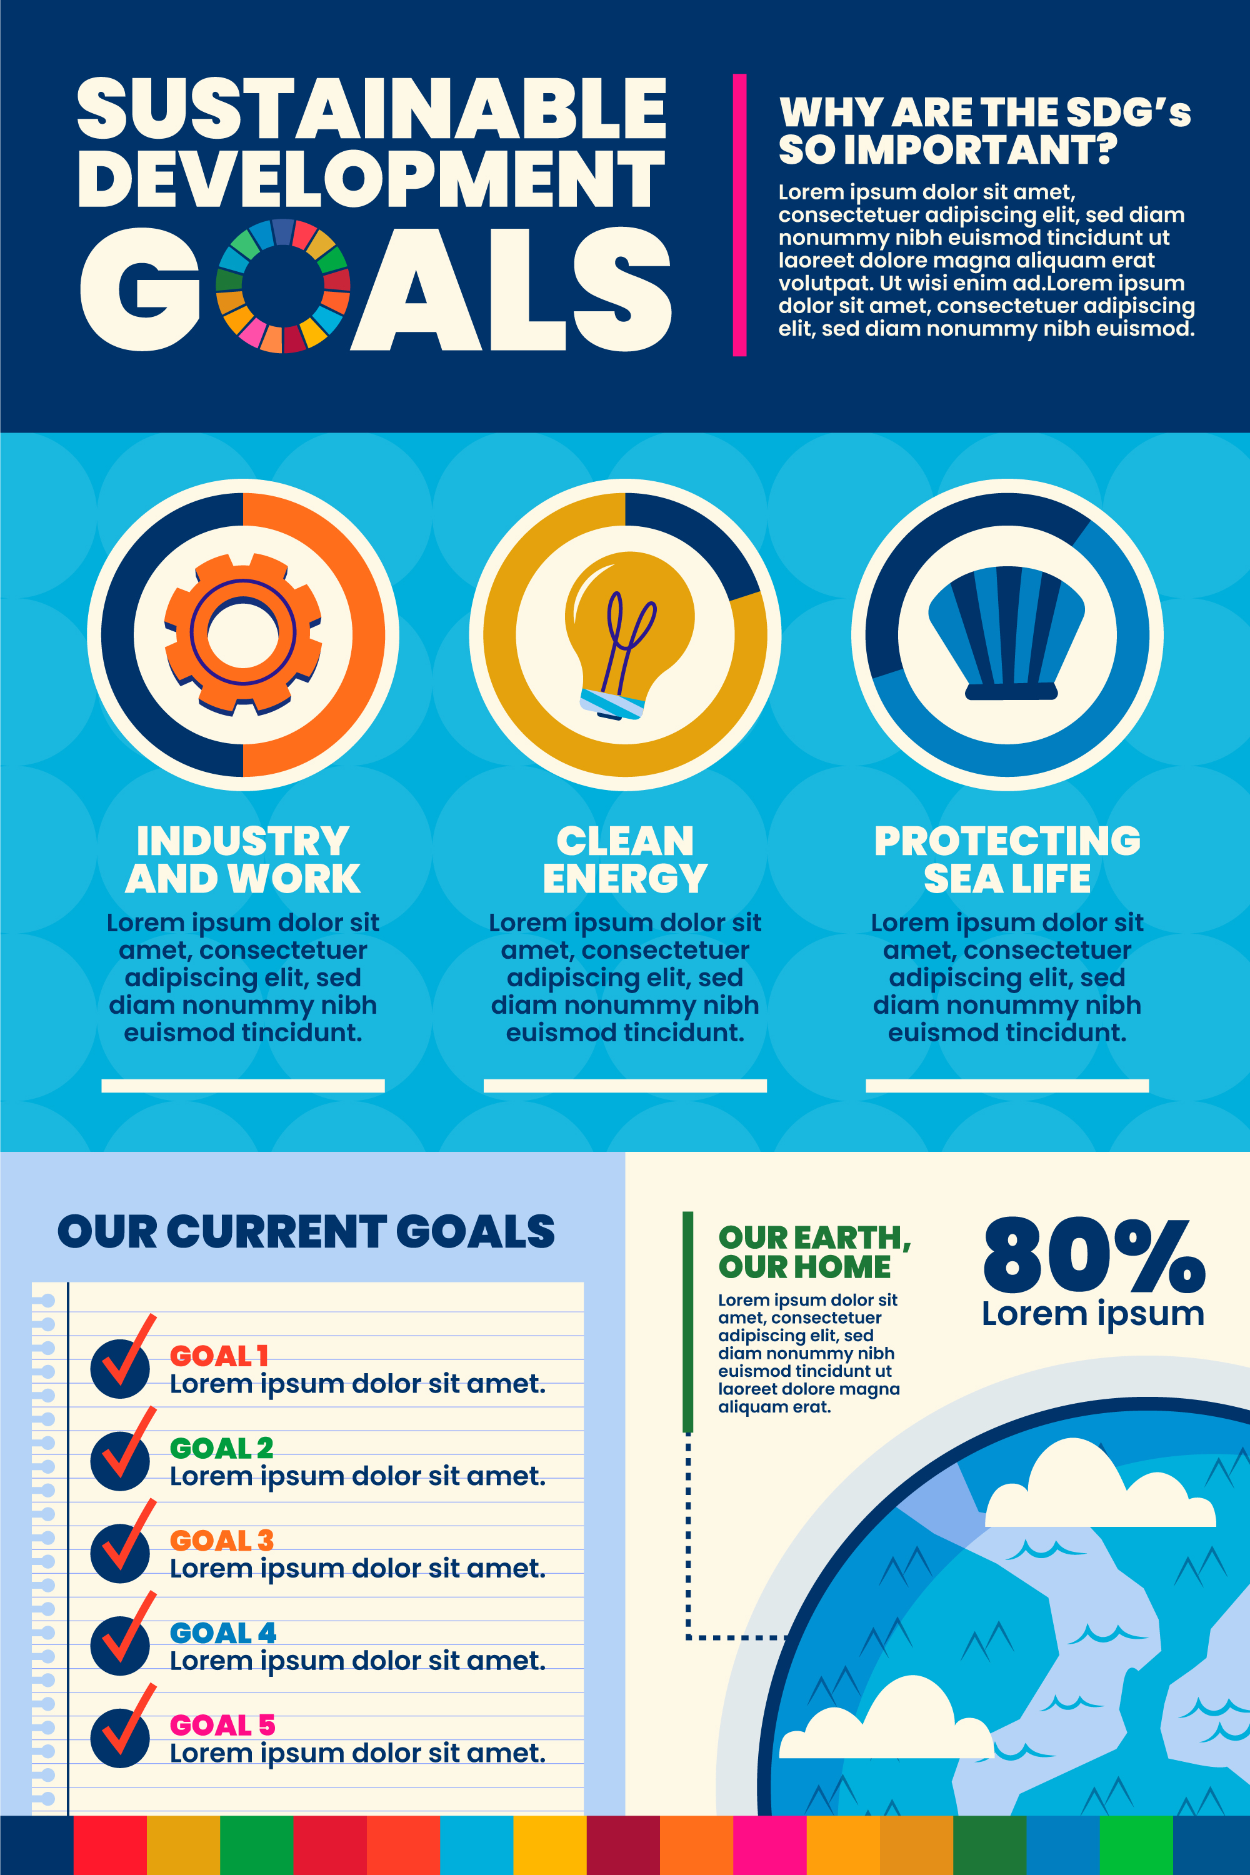
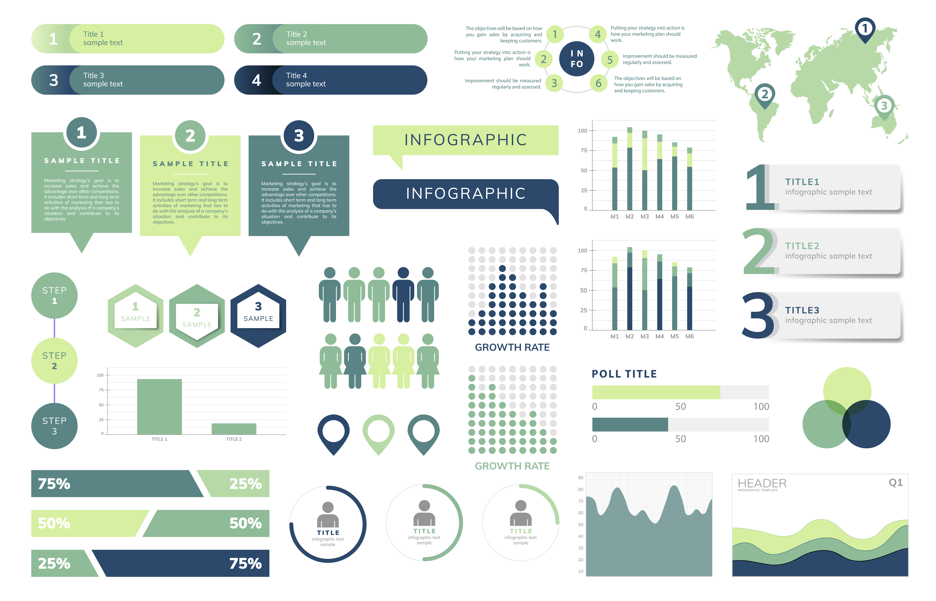
Creating an Infographic

Slide 42
Creating an Infographic
Choose a Topic: Start with the main idea or topic you want to explore, such as a process, timeline, comparison, or data visualization.
Gather information: Collect all the relevant information, data, and visuals (like charts, graphs, or images) you want to include in your infographic.
Plan Layout: Sketch out a rough layout or your infographic, including sections for different information and how you want them to flow.
Select a Tool: Draw or choose a digital tool/software to create your infographic. Canva is an example of a digital tool you can use.
Design the infographic: Start designing your infographic by adding text, visuals, colors, and other design elements. Make sure to use a clear and visually appealing layout.
Organize information: Arrange the information in a logical order, using headings, subheadings, and bullet points to make it easy to read and understand.

Slide 43
References and Tools
Books
Brown, P. C., Roediger III, H. L., & McDaniel, M. A. (2014). Make it stick: The science of successful learning. The Belknap Press of Harvard University Press
Sites
https://pcl.sitehost.iu.edu/rgoldsto/courses/dunloskyimprovinglearning.pdf
https://collegeinfogeek.com/learning/
https://learningcenter.unc.edu/tips-and-tools/studying-101-study-smarter-not-harder/
https://www.edutopia.org/article/5-research-backed-studying-techniques
Videos
Executive Function: Your Brain’s Control Center https://youtu.be/sZmElSGKBG8

